Slide 1
Introduction to Ansible
Ansible is a simple IT automation platform that makes your applications and systems easier to deploy.
It support configuration management with examples as below.
Configuration of servers
Application deployment
Continuous testing of already install application
Provisioning
Orchestration
Automation of tasks
Here, are important land marks from the history of ansible:
It was first developed by Michael DeHaan in February 2012.
In 2015 it was acquired by Redhat.
It is available for Redhat, centos, oracle Linux, Debian and also on Windows.

Slide 2
Why Ansible ?
It is an open source, IT configuration management, deployment and orchestration tool.
(This means with help of single command we can update multiple servers instead of doing manually)
It works on Push based mechanism where server pushes the updates on the machines.
Agent-less – No need for agent installation and management
It uses YAML [Yet Another Markup Language]. YAML works on key-value pair.
Secure: It uses ssh keys to connect to its clients.
Highly Flexible, Simple and human readable.
Can use this tool whether the servers are on premises or on cloud.
It turns your code into infrastructure.
Ansible Tower: GUI based.

Slide 3
Terms used in Ansible
Ansible Server: The machine where ansible is installed and from which all the tasks and playbooks will run.
Module: command or set of similar commands meant to be executed on the client side.
Task: It is a single procedure to be completed.
Role: A way of organizing tasks and related files.
Fact: Information fetched from the client machine with gather-fact operation.
Inventory: File containing data about Ansible client machines.
Play: Execution of playbook.
Handler: Task which is completed only if the notifier is present.
Notifier: Section attributed to a task which calls a handler if the output is changed
Playbook: It consist of code in YAML format, which describes tasks to be executed.
Host: Nodes which are automated by Ansible server.

Slide 4
Push Mechanism(Ansible)
Ansible server
Node 1
ssh
Node 2
ssh
Node 3
ssh
Pull Mechanism (Chef)
Chef-client (Agent)
Node 1
Ohia
CookBook
Knife (CLI Tool)
Node 2
Recipe
Ohia
Chef-server
Node 3
Chef-workstation
Ohia

Slide 5
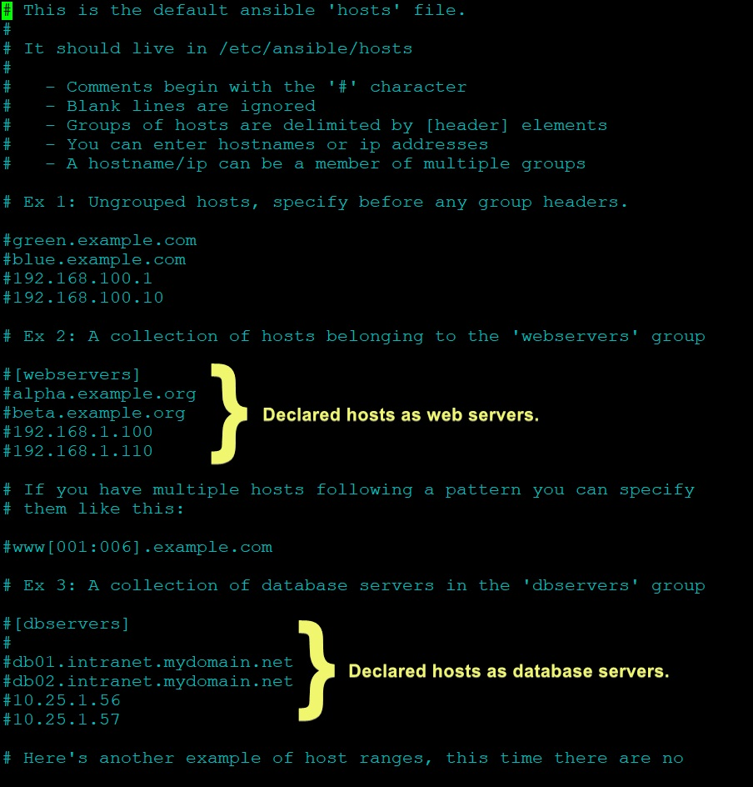
Inventory
It is the description of the nodes that can be accessed by Ansible server.
Inventory is described by configuration file whose default location is /etc/ansible/hosts.
It lists either the ip address or hostname of each nodes that is accessible by ansible server.
Each host is assigned to a group.
Note:
Whenever we install Ansible server package 2 files are created:
/etc/ansible/hosts
/etc/ansible/ansible.cfg
We create groups in the host file and list the private Ip’s or hostname of the nodes.
To enable ssh connection b/w nodes and server we need to make some changes in /etc/ssh/sshd_confg

Slide 6
3 ways to push codes from server to nodes
Adhoc commands (simple Linux command).
Modules -written in YAML (to run one single command)
Playbooks- written in YAML (combination of module)
ADHOC COMMANDS
These commands can be run individually to perform quick functions.
These are not used for configuration management and deployment, because these commands are of one-time usage.
The ansible Adhoc command uses the /usr/bin/ansible cli to automate single task.
Disadvantage: there is no idempotency.
Example: [ansible@ip]$ ansible demo -a “ls”
[ansible@ip]$ ansible all -a “touch file1”
[ansible@ip]$ ansible demo -a “sudo yum install httpd -y”
[ansible@ip]$ ansible demo –ba “yum remove httpd -y”

Slide 7
Idempotency
No repetition of the same task which is already done.
Idempotence is present in almost all modules of Ansible.
This saves CPU time.
How idempotency is achieved in module and playbook
when a playbook is run then a setup module is executed itself. It checks with the nodes if the package is present on those nodes or not. This set up module helps to achieve idempotency.
Set up module gives the information about the current configuration of the nodes like location, IP address, file, folders etc.
It runs in the background continuously.

Slide 8
Ansible Modules
Ansible ships with a number of modules called module library that can be executed directly on remote host via playbooks.
These are Predefined commands which are ship when we install ansible server package.
Your library of module can reside on any machine and there are no servers, daemons or database required.
To execute a module we need to mention -m in command.
Examples: [ansible@ip]$ ansible demo –b –m yum -a “pkg=httpd state=present”
[ansible@ip]$ ansible demo –b –m user -a “name= rajesh”
**Note: install=present, uninstall=absent, update=latest

Slide 9
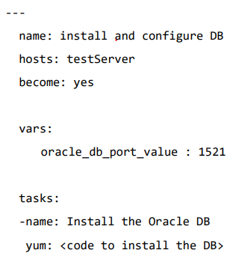
Ansible Playbook
Written in YAML format.
It is humans readable data serialization language.
It is like a file where your write codes which consists of variables, tasks, handlers, files, templates and roles.
Each playbook consist of one or more modules in a list.
Playbooks are divided into many sections like
Target Section: Defines the host against which the playbook tasks has to be executed.
Variable Section: Defines variables.
Task Section: List of all the module or tasks that we need to run in an order.

Slide 10
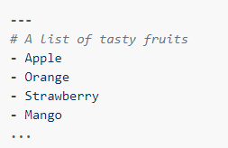
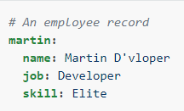
YAML (Yet Another Markup Language)
All YAML files have to begin with “---” and end with “…”
All members of a list lines must begin with same indentation level starting with “-”
A dictionary represents a simple key: value form.

Slide 11
Facts
When Ansible gathers facts, it connects to the host and queries it for all kinds of details about the host.
CPU architecture
operating system
IP addresses
memory info…
This information is stored in variables that are called facts, and they behave just like any other variable.
DRYRUN: check whether the playbook is formatted correctly.
# ansible-playbook playbookname.yml --check

Slide 12
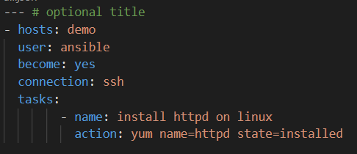
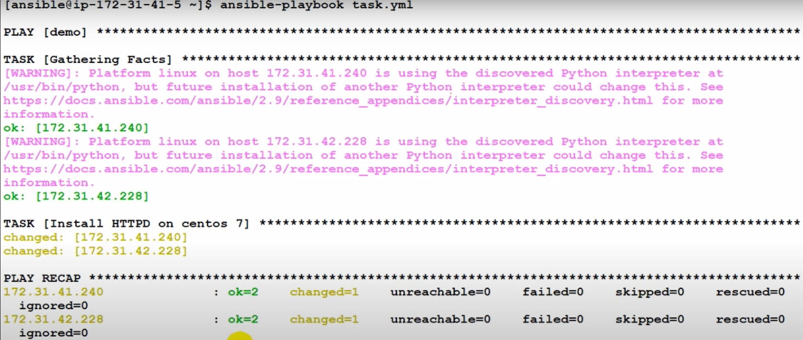
Playbook Example
[ansible@ip]$ vi task.yml [ansible@ip]$ ansible-playbook task.yml

Slide 13
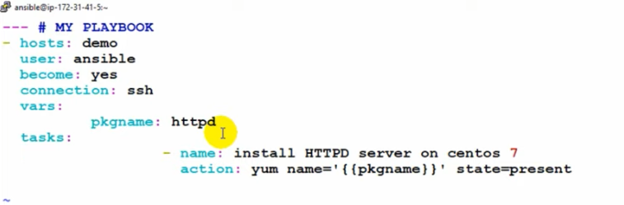
Variables
Variable in playbooks are very similar to using variables in any programming language.
It helps you to use and assign a value to a variable and use that anywhere in the playbook. One can put conditions around the value of the variables and accordingly use them in the playbook.
Put variables section above tasks so that we define it first and use it later.

Slide 14
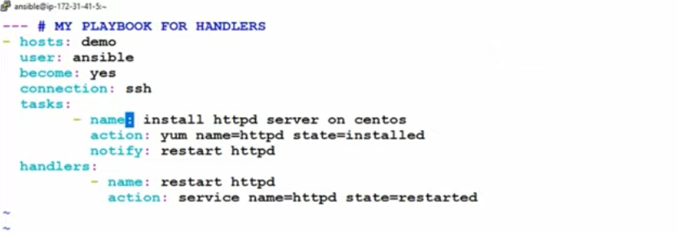
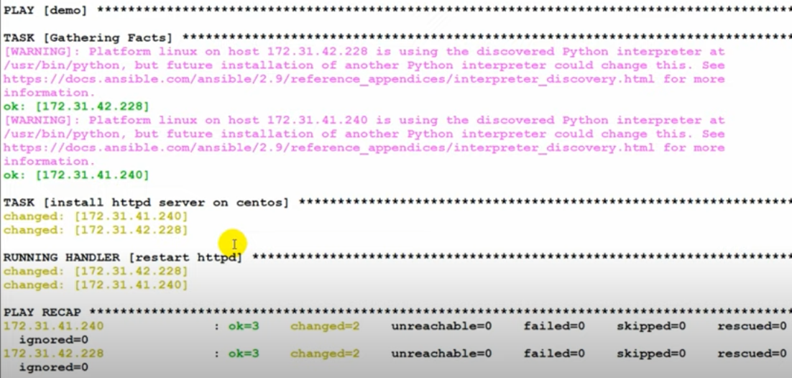
Handlers
Handler is exactly same as the task but it will run when called by another task.
Handlers are just like regular tasks in ansible playbook but are only run if the task contains a notify directive and also indicates that it changed something.

Slide 15
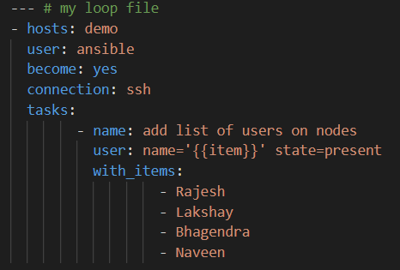
Loops
Sometimes you want to repeat a task multiple times, this is called loop.
Example: you want to create users on all the nodes in demo group.
Note: if you want to check the user then go
to any node and check cat /etc/passwd
file.

Slide 16
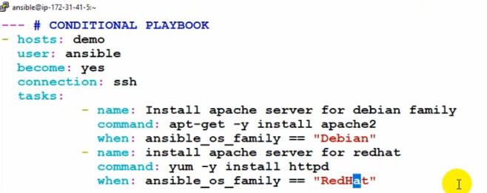
Conditionals
Conditionals are used where one needs to run a specific step based on a condition.
Sometimes you want to skip a particular command on particular node.
Example: Installing apache server on different O.S nodes.

Slide 17

Ansible Vault
Ansible allows to keep your sensitive data such as password or keys in encrypted files, rather than a plaintext in your playbooks.
AES256 encryption is used.
Creating a new encrypted playbook : ansible-vault create vault.yml
Edit the encrypted playbook: ansible-vault edit vault.yml
Change the password: ansible-vault rekey vault.yml
Encrypt the existing playbook: ansible-vault encrypt test.yml
Decrypt the encrypted playbook: ansible-vault decrypt test.yml

Slide 18
Roles
It is the mechanism of breaking a playbook into multiple files.
This simplifies writing complex playbooks, and it makes them easier to reuse.
The breaking of playbook allows you to logically break the playbook into reusable components.
Roles are not playbooks. Roles are small functionality which can be independently used but have to be used within playbooks
We can organize playbooks into a directory structure called roles.
Adding more and more functionality to a playbook will make it difficult to maintain in a single file.
Roles
Default
Files
Handlers
Meta
Templates
Tasks
Vars

Slide 19
Types of Role directory
Default: It stores the data about role/application default variable. For ex: If you want to run to port 80 or
8080 then variables need to define in this path.
Files: It contains the files needed to be transferred to remote VM.
Handlers: They are trigger or tasks. Used to store all the handlers.
Meta: The meta-directory is supposed to have information about the author and role dependencies.
Tasks: It contains all the tasks in the playbook.
Vars: all the variables used by the role will be defined.

Slide 20
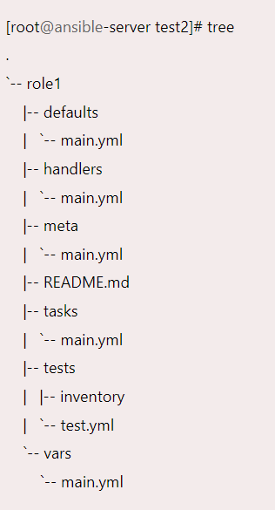
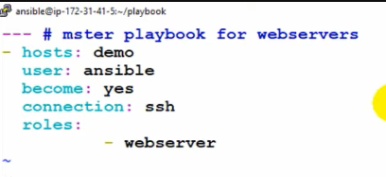
Example:
playbook
master.yml
Roles
WeW
Webserver
Targets
Roles
- Webserver
Tasks
Handlers
Vars

Slide 21
Thank you

